Slide 1
The battle of Neighbourhoods In new york
Xin Zhang

Slide 2

Contents:
Background
Problems
Data source
Methodology
Result
Conclusion

Slide 3
Background
New York City (NYC), often called The City or simply New York (NY), is the most populous city in the United States. New York is also the most densely populated major city in the United States. Located at the southern tip of the U.S. state of New York, the city is the center of the New York metropolitan area, the largest metropolitan area in the world by urban landmass
Situated on one of the world's largest natural harbors, New York City is composed of five boroughs, each of which is a county of the State of New York. The five boroughs—Brooklyn, Queens, Manhattan, the Bronx, and Staten Island.
The city and its metropolitan area constitute the premier gateway for legal immigration to the United States. As many as 800 languages are spoken in New York, making it the most linguistically diverse city in the world. With New York City’s diverse culture, comes diverse food items. There are many restaurants in New York City, each belong to different categories like Chinese, Indian, French, Italian etc.

Slide 4
Problems
List and visualize all major parts of New York City that has Chinese restaurants
What is the best location in New York City for Chinese Cuisine?
Which areas have potential Chinese Restaurant Market?
Which all areas lack Chinese Restaurants?
Which is the best place to stay if you prefer Cuisine?

Slide 5
Data source
New York City data that contains Boroughs, Neighborhoods along with their latitude and longitude.
Data source: https://geo.nyu.edu/catalog/nyu_2451_34572
This dataset contains the required information, such as latitude, longitude. And we will use this dataset to explore various neighborhoods and borough of New York City.
Chinese Restaurants in each neighborhood of New York City
Data source: Foursquare API (only 50 premium calls each day)
GeoSpace Data
Data source: https://data.cityofnewyork.us/City-Government/Borough-Boundaries/tqmj-j8zm

Slide 6
Methodology
We begin by collecting the New York city data from https://cocl.us/new_york_dataset.
We will find all venues for each neighborhood using Foursquare API.
We will then filter out all Chinese Restaurant venues.
Next using Foursquare API, we will find the Ratings, Tips, and Like count for all the Chinese Restaurants.
Next, we will sort the data keeping Ratings as the constraint.
Finally, we will visualize the Ranking of neighborhoods using python's Folium library.

Slide 7
Results
The number of Neighborhoods in each Borough of New York City

Slide 8
Results
The number of Chinese Restaurants for each Borough

Slide 9
Results
The number of Neighborhoods in each Neighborhood of New York City

Slide 10
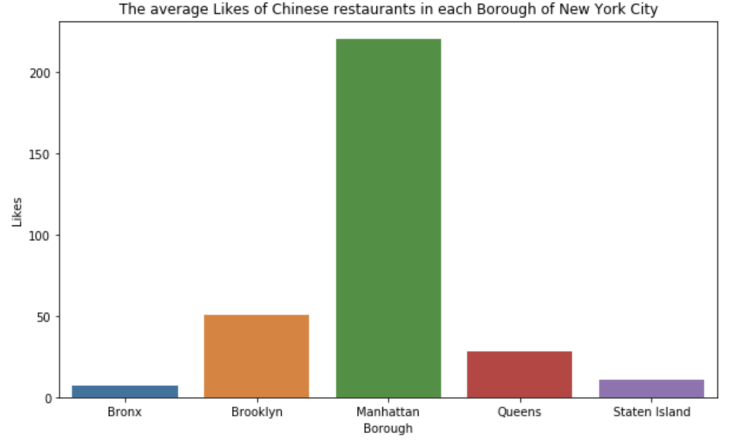
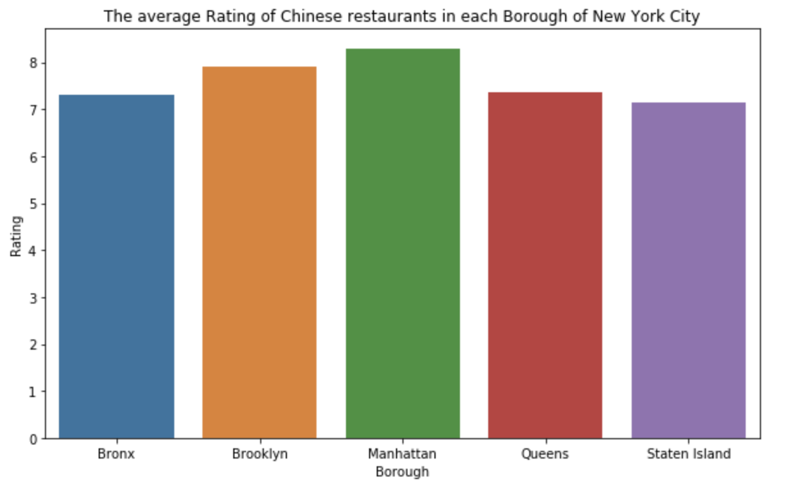
Results
Borough with average Likes and Rating of Chinese restaurants

Slide 11
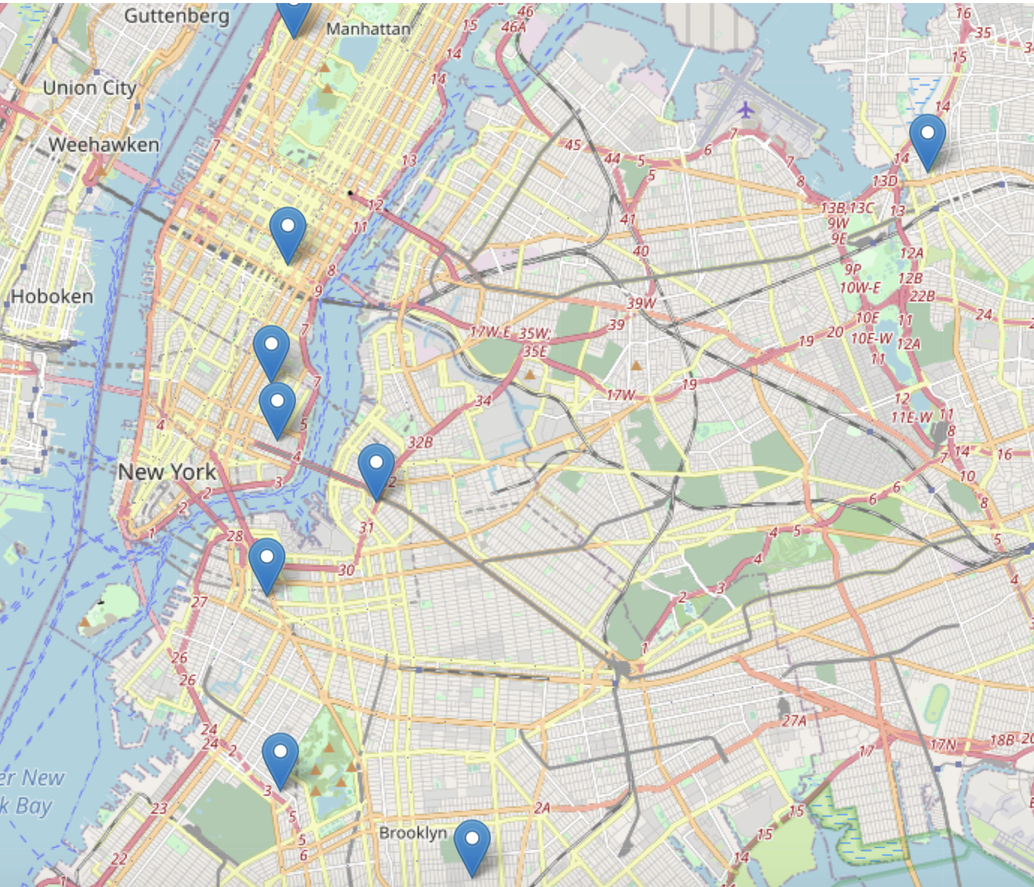
Results
Top10 maximum rating of Chinese restaurants across New York City on map

Slide 12
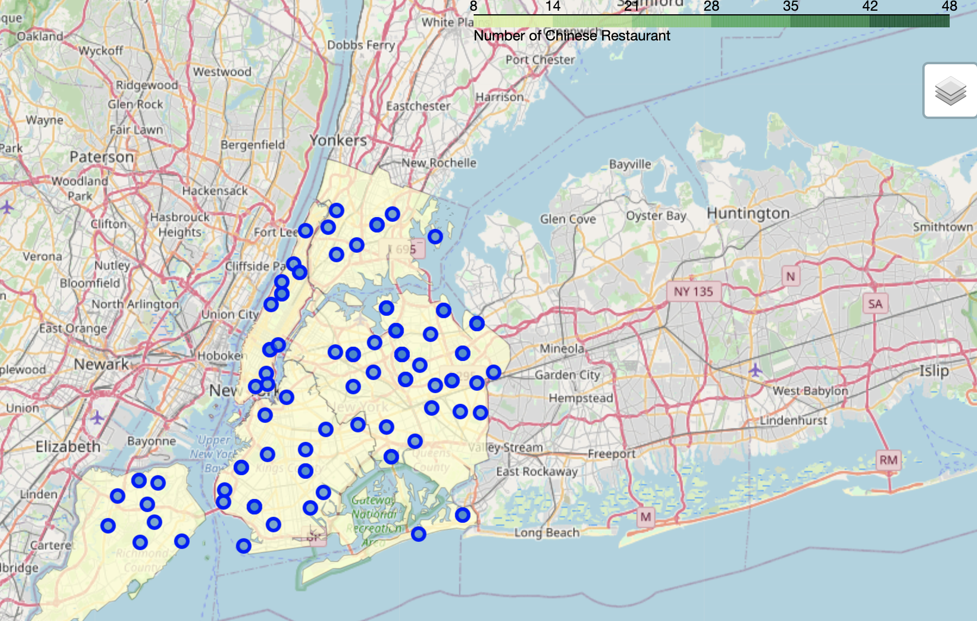
Results
Distribution of Chinese Restaurants across New York City on the map

Slide 13
Conclusion
Queens has the most Chinese restaurants and Bronx and Manhattan have the low number of Chinese restaurants. Therefore, Queens borough is the best place to open a Chinese restaurant market.
According to the data shows, I think Manhattan is the best choice for you to enjoy Chinese cuisine. Because the average amount of customers likes and average rating of Chinese restaurant are leading all five boroughs. Therefore, I recommend that you’d better to go to Manhattan if you want to have the best Chinese food experience.

